Slide 1
CST8234 – C Programming
Week 10b – Process Control
December 15th, 2017

Slide 2
Process Control
Having eliminated the a lot of the mundane topics (e.g., file handling, structs, memory management), we can finally get down to some fun stuff!
C allows you to create multiple processes, that can all interact
With each other
With the system

Slide 3
Process Control
E.g., in a game, you want to have a bunch of AI players in addition to your human players
In turn-based games (e.g., card games, many mobile “RPG” games) this isn’t necessary
Human Player 1 attacks
AI Player 2 attacks
AI Player 3 attacks
Human Player 4 attacks
Repeat sequence above until one player is left

Slide 4
A Turn-Based Game
In turn-based games all you need is an array of Players, and a function pointer or two
struct Player { int id; char *name; struct Stats { short atk; short def; short hp; } stats; void (*fpAttack)( struct Player *pPlayer ); };

Slide 5
A Turn-Based Game
And given distinct attack functions
void attack_AI( struct Player *pPlayer ) { /* randomly pick an opponent */ /* randomly pick a skill to use */ /* update both players’ stats */ }
void attack_Human( struct Player *pPlayer ) { /* prompt the user to pick an opponent */ /* randomly pick a skill to use */ /* update both players’ stats */ }

Slide 6
A Turn-Based Game
You can then define
struct Player players[] = { { 1, “Dave”, { 18, 12, 30 }, &attack_Human }, { 1, “Computer 1”, { 16, 15, 25 }, &attack_AI }, { 1, “Computer 2”, { 12, 20, 40 }, &attack_AI }, { 1, “Jesse”, { 20, 10, 36 }, &attack_Human } }
Then we can loop until we’re done
for ( iPlayer = 0; iPlayer < MAX_PLAYERS; iPlayer++ ) { if ( ! isDead( iPlayer ) ) players[iPlayer].fpAttack( &players[iPlayer] ); if ( isVictorious( iPlayer ) ) break; }

Slide 7
Process Control
But… what happens if it’s NOT turn-based…
any RTS game, any FPS, any MOBA
or where you have attacks that automatically trigger after delays, or have options with cool downs?
Or, moving away from gaming… what happens if you
need to be simultaneously controlling multiple robotic arms?
Just want to spawn multiple workers who operate independently on different resources?

Slide 8
Multiple Processes
In many cases you’ll want distinct processes
I.e., the OS knows about multiple instances of your program
How does the OS manage multiple processes?
There are a limited number of processors: e.g., 1 (very frequently), or dual- or quad-core systems
Regardless, the OS will be simultaneously running hundreds, if not thousands, of processes
Consequently, it is impossible for each processor to be dedicated to just one process

Slide 9
Time Slices
Operating Systems manage that by allocating each application a tiny slice of time…
I.e., MS Word gets .863 ms, then your Cygwin window gets .120 ms, then Chrome gets .555 ms, then MS Word gets another .623 ms, then Chrome gets some more time…
But during that time slice, the processor is completely dedicated to that process…
I.e., all the processors’ registers contain values related to your process, the CPU is stepping through your program’s instructions, the address buffers are accessing your program’s memory (heap or stack)

Slide 10
Context Switching
But then… your process’ time slice is over, and the processor has to give it’s attention to a different process for a while
So all of your process’ registers, addresses, program counter, etc. have be recorded so that the processor will know where it has to pick up from, the next time it’s your processes return
It saves everything in memory in a struct called a “context”
It then looks up the context of the process that is now the focus of the processor’s attention, and loads everything in that process’ context
And that process proceeds exactly from where it left off, for the next few microseconds or milliseconds, until another process gets a shot
The sequence of saving one process’ context, loading another process’ context, and then continuing execution of that new process is called “context switching"

Slide 11
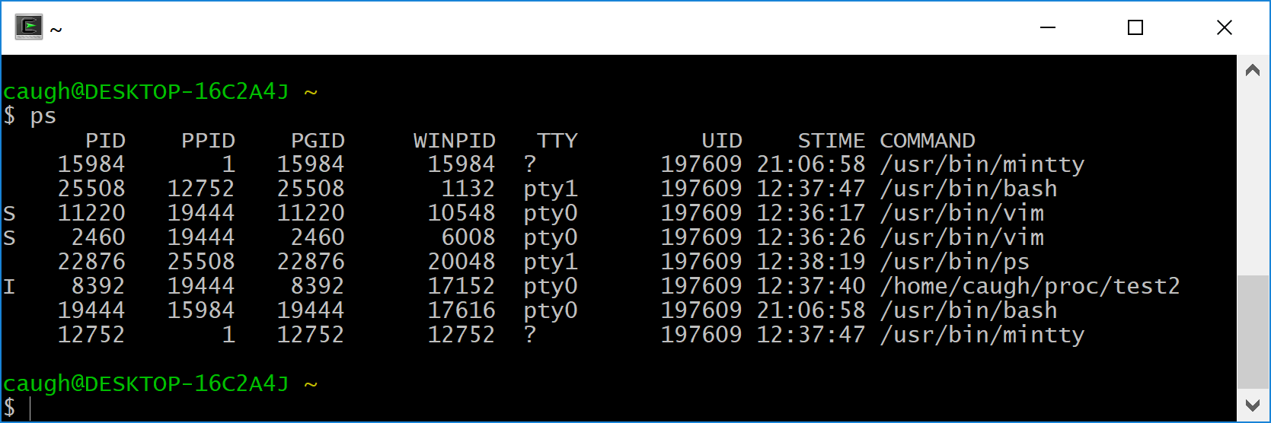
Context Switching
Much of this is the focus of a Real-Time Operating Systems course
However, we can see how the OS is managing it’s process by running the command ‘ps’ (or Task Manager on Windows)
You can find out process ID’s (important!)
Status
CPU Time

Slide 12
Forking
If you call ‘int pid = fork();’ a C program will make an EXACT COPY of itself
And each copy will continue executing (i.e., from the line after the ‘fork’)
The ONLY difference is that one process will find that ‘fork’ returns a ‘0’, and the other returns a non-zero process ID of the newly created process
But otherwise, each copy will have the same memory, the same functions, etc…
But each variable is a COPY… it is NOT SHARED

Slide 13
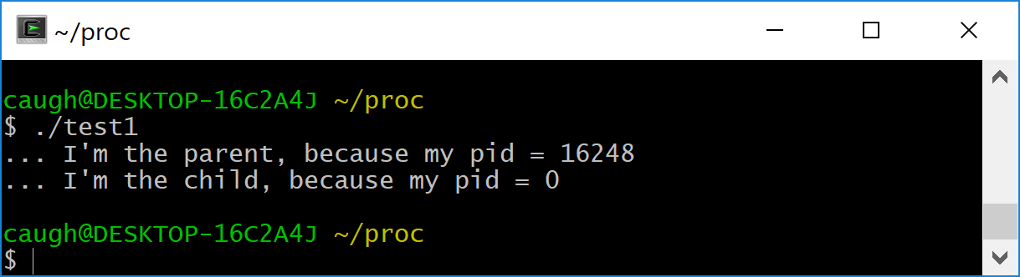
Our First Multi-Process Program
#include <stdio.h> #include <unistd.h> int main( int argc, char *argv[] ) { int pid = fork(); printf( "... I'm the %s, because my pid = %d\n", pid==0?"child":"parent", pid ); }

Slide 14
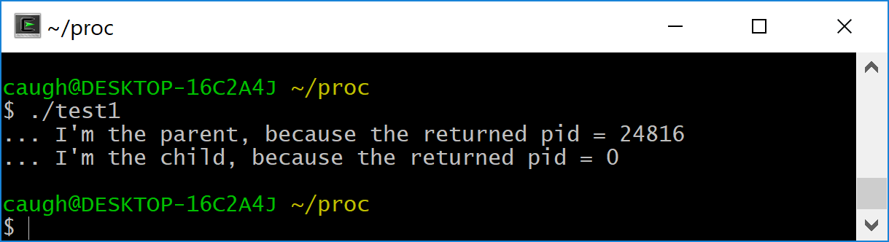
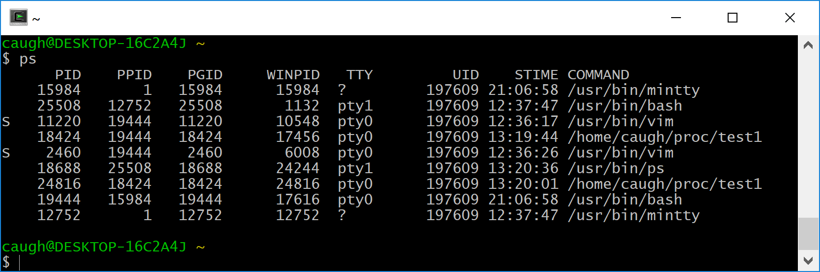
Did it Really Work?
int main( int argc, char *argv[] ) { int pid = fork(); printf( "... I'm the %s, because the returned pid = %d\n", pid==0?"child":"parent", pid ); sleep( 10 ); }

Slide 15
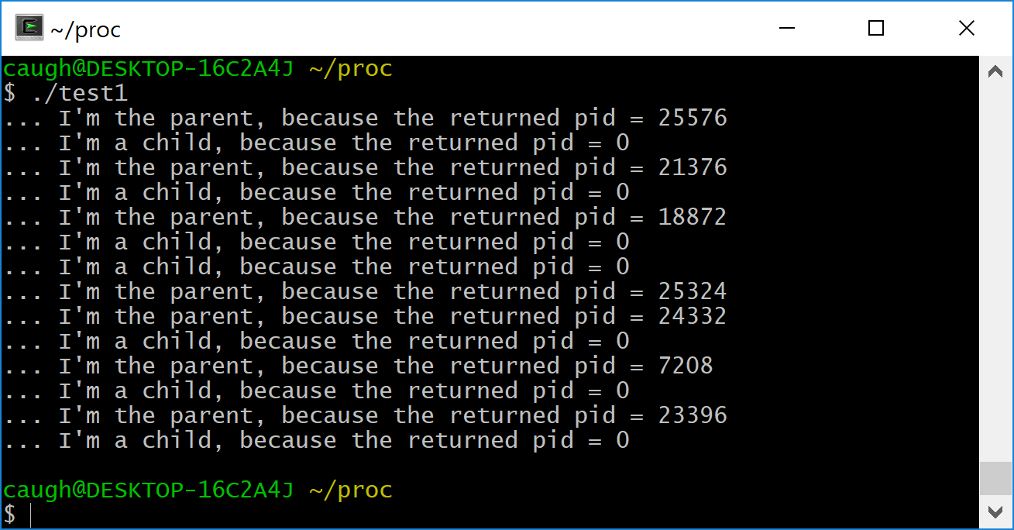
Not Limited to Just a Single Fork
int main( int argc, char *argv[] ) { int i; for ( i = 0; i < 3; i++ ) { int pid = fork(); printf( "... I'm %s, because the returned pid = %d\n", pid==0?“a child":“the parent", pid ); } }

Slide 16
What? I Expected THREE Child Processes
I expect that I would loop three times, and each time I would fork another process… so I’d end up with a parent and three children
But… the second time through the loop, BOTH the original parent AND the child forked
And the third time through the loop, all four processes forked…
So I ended up with 1 + 2 + 4 = 7 children
Some of which were child processes of child processes of a child process

Slide 17
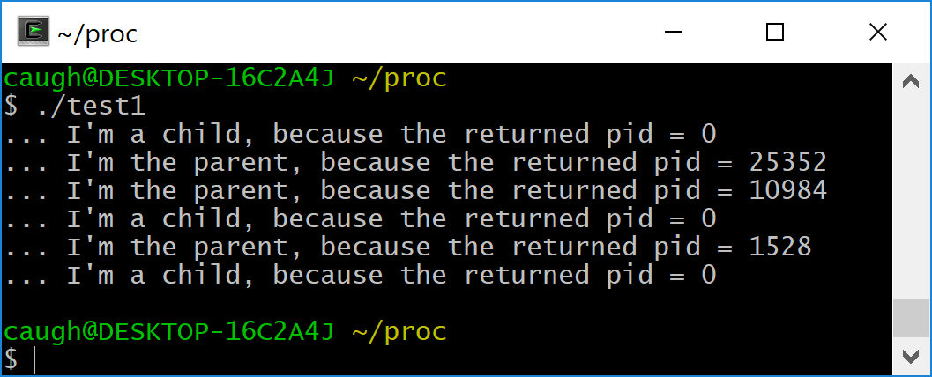
What? I Expected THREE Child Processes
The value returned from ‘fork()’ is important!
int main( int argc, char *argv[] ) { int i; int pid = -1; for ( i = 0; i < 3 && pid != 0; i++ ) ← don’t keep looping if I’m a child { pid = fork(); printf( "... I'm %s, because the returned pid = %d\n", pid==0?“a child":“the parent", pid ); } }

